Slide 1
Awesome Inc.
IoT Solutions

Slide 2
Who is Awesome Inc.?
Brandon Adams – Java / C++ Developer
Chris Costa– C# / Java Developer
Yunkai Deng– Java / C# Developer
David Palmieri– Java / C# Developer
Nate Poli– C# / Java Developer

Slide 3

What is IoT (Internet of Things)
The Internet of Things (IoT) is the network of physical objects, devices, vehicles, buildings and other items which are embedded with electronics, software, sensors and network connectivity, which enables these objects to collect and exchange data.
The Internet of Things allows objects to be sensed and controlled remotely across existing network infrastructure.

Slide 4
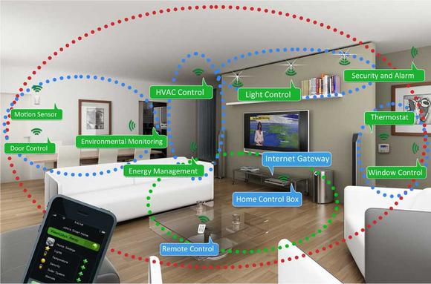
Examples
Motion Sensor
Door Control
Environmental Monitoring
HVAC Control
Lighting Control
Window Control
Security and Alarm
Thermostat
Energy Management

Slide 5
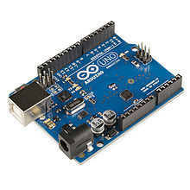
Arduino
Arduino is an open-source computer hardware and software company, project and user community that designs and manufactures microcontroller-based kits for building digital devices and interactive objects that can sense and control objects in the physical world.

Slide 6
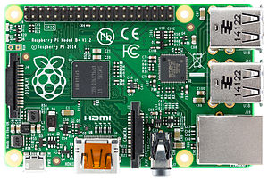
Raspberry Pi
The Raspberry Pi is a credit card sized single board computer developed by the Raspberry Pi Foundation with the intention of promoting the teaching of basic computer science in schools and developing countries.

Slide 7

LiveSmart Project
We’re thrilled to announce the development of a smart home system that can not only bring in new technology at a fraction of our competitor’s price, but can also work with the technology that already exists in the household! From lighting that knows when to turn on, to setting a schedule for the children’s television, all operations are controlled by LiveSmart, our very own application software that gives the most flexibility where you need it… in the home!

Slide 8
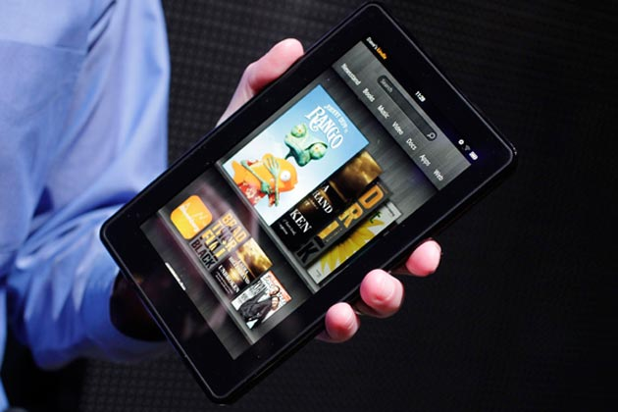
App Interface
Fire OS
Android
iOS
Web Browser

Slide 9
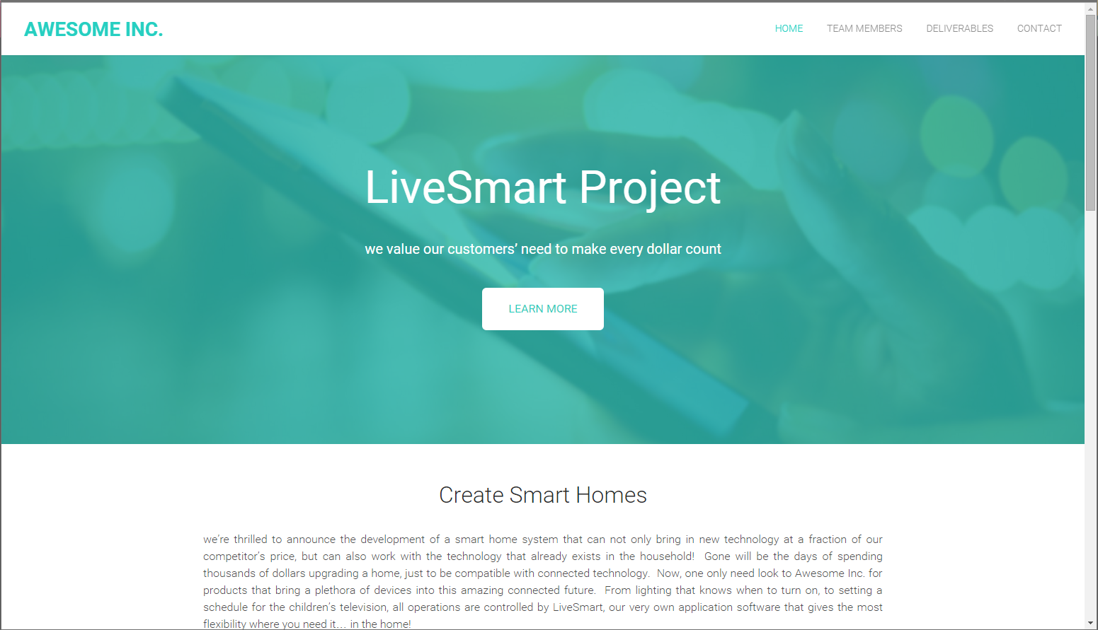
Website
http://livesmartproject.weebly.com/

